Slide 1
Greyhound Chromatography
Reference Materials
August 2020
Advance your analysis with expert technical support

Slide 2
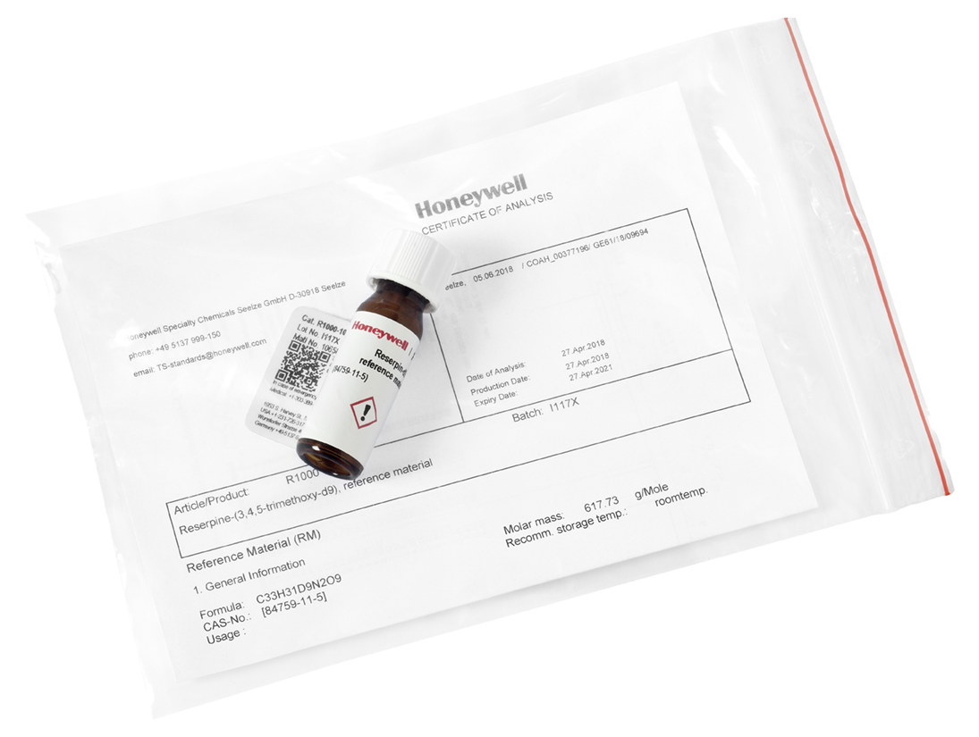
Honeywell Fluka™ Standards
533 Fluka™ branded Reference Materials for Analytical Applications
Features
We offer the most comprehensive technical documentation
We have a dedicated team of experts in the lab
We provide unmatched flexibility and expertise in customization
Find out more at lab-honeywell.com/standards
Fluka is a registered trademark of Honeywell Specialty Chemicals, Seelze.
Notes:
4

Slide 3
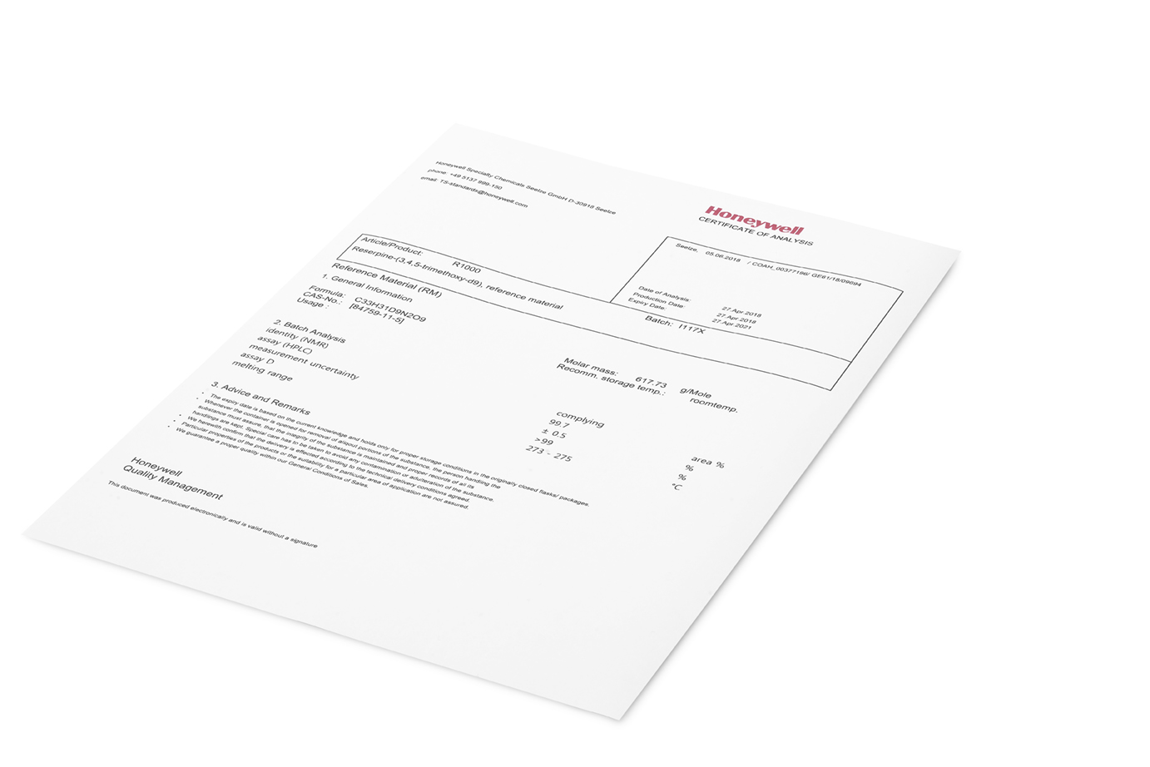
Documentation - Advance your analysis
Certificate of Analysis
Delivered with the products & available online
Contains comprehensive product information
Safety Data Sheet
Prepared according to our strict HON compliance guidelines
Provides valuable information about the product hazards
Label
Consistent format for all products in our portfolio
Makes it easier to read the label and find information
Contains important information like lot number, physical properties, expiry date, contact and hazard information
We offer a comprehensive Certificate of Analysis (CoA).
Find out more at lab-honeywell.com/standards
Fluka is a registered trademark of Honeywell Specialty Chemicals, Seelze.

Slide 4
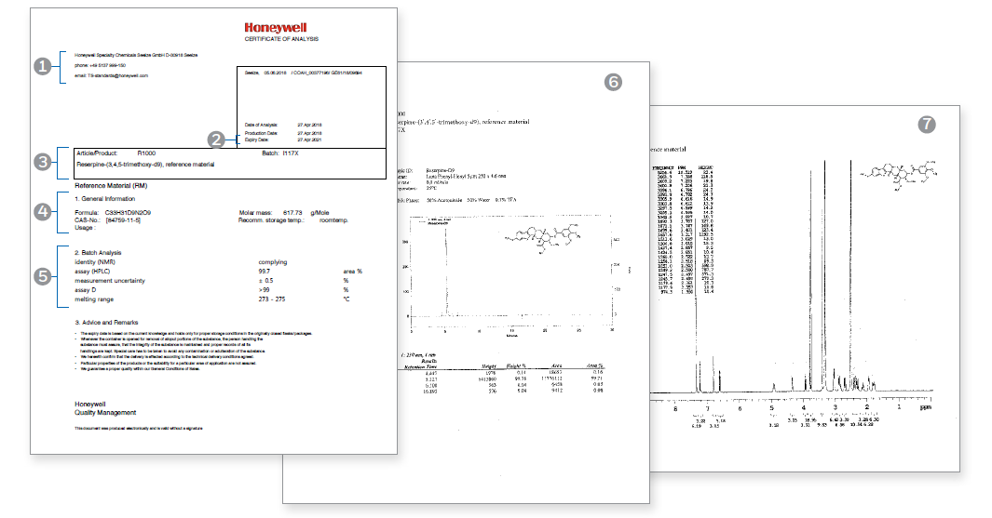
Documentation - Certificate of Analysis (CoA)
Each CoA includes:
1. Contact and technical support details
2. Expiry date
3. Product number, name and batch
4. General product information
5. Lot specific analytical results
6. Purity test by HPLC, GC, LC-MS, GC-MS
and Titration
7. Identity test by NMR, FT-IR or
Mass Spectrometry
Find out more at lab-honeywell.com/standards
Fluka is a registered trademark of Honeywell Specialty Chemicals, Seelze.

Slide 5
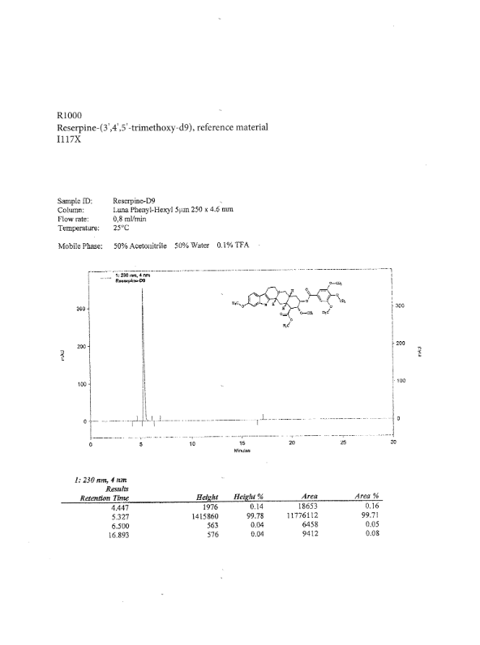
Documentation - Certificate of Analysis (CoA)
Purity test by HPLC or GC
Information used to quantitative analytical results. Method included to verify and reproduce analytical method.
Find out more at lab-honeywell.com/standards
Fluka is a registered trademark of Honeywell Specialty Chemicals, Seelze.

Slide 6
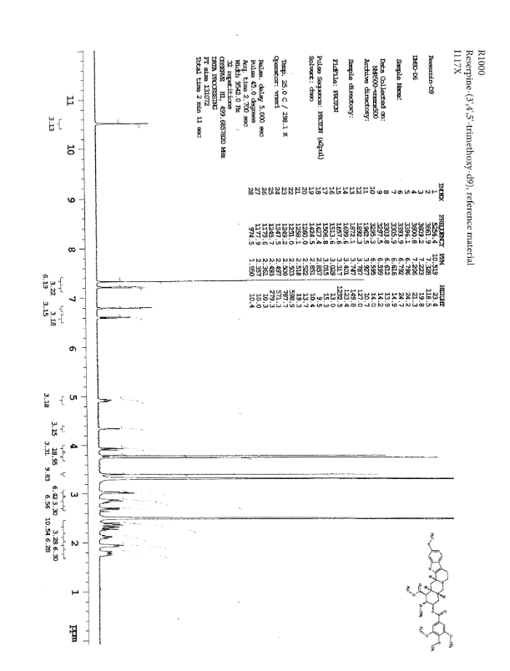
Documentation - Certificate of Analysis (CoA)
Identity Test by NMR, FT-IR or Mass Spec
Proof of the identity. Additional information about the structure and impurity profile of the product.
Find out more at lab-honeywell.com/standards
Fluka is a registered trademark of Honeywell Specialty Chemicals, Seelze.

Slide 7
Technical Service – Advance your analysis
Single Point of Contact
Get a direct connection to the expert team in the lab
We provide dedicated technical support for all types of standards. Examples are:
Solubility issues
Analytical methods
Appearance, form
Additional test parameters
Chemical structure
Handling issues
Sourcing requests
Contact for tailor-made solutions
Pdf forms for multicomponent mixtures
Feasibility and stability studies
Cost calculation
Find out more at lab-honeywell.com/standards
Fluka is a registered trademark of Honeywell Specialty Chemicals, Seelze.

Slide 8
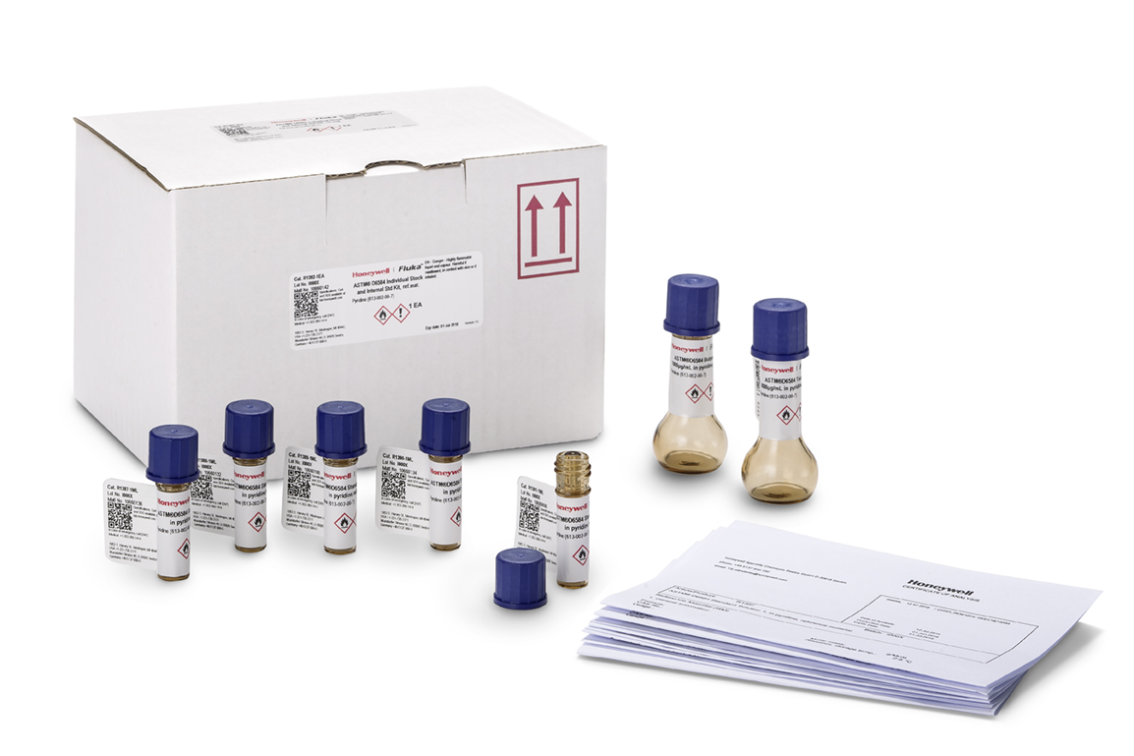
Technical Service – Advance your analysis
Get a direct line to our experts in the Lab
ts-standards@honeywell.com
Tel: +49 (0)5137 999 150
• We solve the majority of customer product enquiries after one email or phone call
• More complex application troubleshooting is normally resolved within 5 working days
Find out more at lab-honeywell.com/standards
Fluka is a registered trademark of Honeywell Specialty Chemicals, Seelze.

Slide 9
Standards product categories
Environmental Standards
Food and Cosmetic related compounds
Pharmaceuticals and Veterinary Drugs
Alkylphenole
Cyanamide
Flame retardants
Nitroimidazoles
Triazines
Alkaloids
Aliphatics
Amide
Biocides
Cyanobacterial Toxins
Dyes, Feed additives
Flavours & Fragrances
Mycotoxins
Parabene
Plasticizers
ACE Inhibitors
Anesthetics
Anthelmintics, Flukicides
Antibacterial Agents
Antibiotics
Anticoccidial
Antiemetics
Antiprotozoal Agent
Benzimidazole
beta-Agonist, Antagonists
Coccidiostat
Hydantoins
Imidazoles
Neuroleptics
NSAIDs
Polypeptides
Retinoides
Steroids, Hormones
Sulfonamides
Tranquilizer
Pesticides and metabolites
Acaricides, Insecticides
Fungicides, Bactericides
Herbicides
Molluscicides
Plant growth regulators
Rodenticides
Petrochemicals
Biofuels
If you can’t find a standard, please contact us at ts-standards@honeywell.com or Tel: +49(0)537 999 150
Find out more at lab-honeywell.com/standards
Fluka is a registered trademark of Honeywell Specialty Chemicals, Seelze.

Slide 10
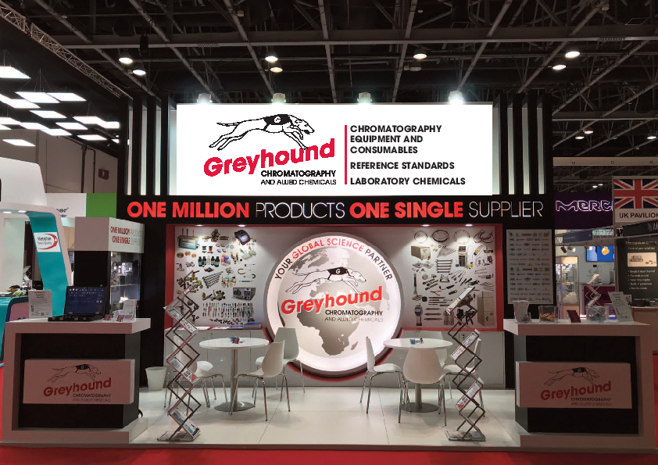
Greyhound Chromatography Company Profile
Company Description
Greyhound Chromatography has been supplying high quality chromatography consumables to Research and Analysis laboratories around the world for 39 years. Greyhound’s Managing Director, Paul Massie, founded the company which operates from its UK facility, located in Birkenhead, Merseyside.
Greyhound Chromatography is a leading global manufacturer and distributor of the highest quality chromatography columns, certified reference standards
and materials, research chemicals, solvents, reagents, and laboratory consumables available today. Greyhound supplies scientists working in all disciplines, including HPLC and Gas Chromatography.
Greyhound Chromatography is probably the leading single source of chromatography products and chemical standards anywhere in the world.
Major Products/Services
Analytical syringes, balances and scales, organic/inorganic reference standards and materials, diluters and dispensers, fittings, flash cartridges, gas filters, gas purifiers/filters/traps, gas regulators, GC columns, GC derivatisation reagents, GC ferrules; seals & inlet liners, HPLC columns; pumps, column heaters & lamps, maintenance tools, membrane filters, TLC consumables, pipettes and tips, prep silica, reagents, solvents, solvent safety solutions, SPE cartridges, syringe accessories, syringe filters, tubing, valves, vials/caps/septa, vial accessories, well plates.
Chief Chromatographic Techniques Supported
All chromatography techniques including:
Chiral chromatography
Derivatives analysis
Environmental analysis
GC and GC-MS
LC-MS
HPLC and UHPLC
ICP, ICP-MS
AA (Atomic Adsorption) spectroscopy
Ion chromatography
SPE and SPME
TLC
WWW.GREYHOUNDCHROM.COM

Slide 11
Greyhound Chromatography Company Profile
Markets Served
Testing reference standards, chemicals, solvents
and reagents, laboratory consumables, for analysis and research & development laboratories:
Cosmetics
Environmental: water, air, soil
Energy: electricity, gas, solar, atomic, renewables
Food
Fragrance: including additives to consumer products
Chemical: anything classed as a chemical that is present in the manufacture or use of consumables
Petrochemical: oil, gas, petroleum
Pharmaceutical: testing standards
Facilities
Greyhound Chromatography operates from a warehouse and office facility, with 5,500 sq ft capacity. Approx. 3,500 sq ft
are used as warehouse storage with temperature controlled zones that include refrigerators and a freezer for product storage. Temperatures are recorded and monitored. An external temperature-controlled container is used to store flammable liquids

Slide 12
Greyhound Chromatography and Allied Chemicals
CONTACT INFORMATION
Address:
6 Kelvin Park, Birkenhead, Merseyside, CH41 1LT, UK
Tel: +44 (0) 151 649 4000 Fax: +44 (0) 151 649 4001
Email: info@greyhoundchrom.com
Sales: sales@greyhoundchrom.com Orders: orders@greyhoundchrom.com
WWW.GREYHOUNDCHROM.COM

Slide 13
lab-honeywell.com/standards
Fluka is a registered trademark of Honeywell Specialty Chemicals, Seelze.
Notes:
4
4
18

